Slide 1
Welcome to PG1
Programming I

Slide 2
Agenda
Contact Information
Introductions
Class expectations
Campus
Online
Everyone
Purpose of this class
Overview of Software Engineering
Software for class
Visual Studio
Discord
Other software
C# Input & Output
Creating a new Visual Studio project
Submitting assignments
Programmer’s Choice assignment

Slide 3
Contact information
Office hours
M-W-F 8:30 – 9AM (EDT) via zoom or discord
As needed/on demand via zoom or discord
Other times by appointment
Contact info:
Discord – direct/private message should be your first choice
Email: charlesm@fullsail.com
Office phone: (407) 697-0100 x7922

Slide 4
Introductions
Who are you?

Slide 5
Introductions
Welcome to PG1
My name is Charles Martin
Please call Marty or Mr. Marty
My contact information and office hours are on slide #3

Slide 6
Introductions
Some facts about me
Currently on my 12th US President
Born and grew up in Central Texas
Retired from US Navy
Married my wife (also Navy retired) in Misawa Japan
Raised 5 children (well my wife did, but I was there…)
Have 11 grandchildren (1 year old to 19 years old, as of January 2021)
Graduated from the University of Maryland Baltimore County (UMBC)
Knowledge and/or experience with several programming languages, including
C#, Java (certified), C, C++, Pascal, Assembler (IBM 370), Cobol, Fortran, Basica
One interesting fact about me is that I’m colorblind (Red-Green)

Slide 7
Class expectations
Campus
Attend every class and lab session
Pay attention and participate in class
Online
Log in daily, if your schedule permits, (to FSO and discord) to keep up with any posted instructions or changes to due dates or assignments
Review materials posted on FSO and watch all the videos related to the current topic
Do your best to do a little each day (as your schedule permits). Putting everything off until the weekend will make the class much more difficult
Try to attend any additional online tutorial or Q&A sessions offered

Slide 8
Class expectations
Everyone
Ask questions as often as necessary to make sure you are acquiring the material
Use the resources available to you to get extra help (discord class group, lab instructors, tutoring center, online resources, my office hours, etc.)
Keep in mind that I am not available 24* hours a day, so you should reach out for help from the lab instructors, other students or even try to find answers on the Internet
If I am not available, I will still get back to you as quickly as I can (no later than one day Mon-Fri). On weekends, my response may be a good bit slower. This class is offered on campus and online. As such, communication should be by online means (discord, Zoom, etc.)
Try to complete optional (ungraded) assignments to prepare for assessments

Slide 9
Class expectations
Everyone (continued)
Do your best on labs, practical assessments and exams
Don’t just give up – ask for help when you need it
When completing labs, try to figure out a solution on your own before asking for help. However, if you are stuck, do not spend ‘too much time’ trying to come up with something. There is not set ‘too much time’ – it will vary with each individual. You should recognize when you’ve reach that point

Slide 10
Class expectations
Everyone (continued)
Submit completed assignments on time
Late assignments are accepted
There is a 10-point penalty for each day the assignment is late
The maximum late penalty is 30% of the portion that is late
Please note:
Assignments will not be accepted after I have provided my solution in class or online
Under no circumstance will late assignment be accepted after the last day of class

Slide 11
Purpose of this class
Why are you here?

Slide 12
Purpose of this class
The reason for PG1 is to familiarize students with:
Programming terminology
Programming structures
Programming statements
Programming operations
Basic Problem-Solving
Please notice You are learning programming/software engineering, not a specific programming language
Throughout the course we will use the C# language to illustrate a variety of programming concepts. However, the concepts are applicable to all modern programming languages

Slide 13
Overview of Software Engineering
This is what we do

Slide 14
Overview of SW Engineering
A career as a software engineer will entail a great deal of problem-solving and research
You will be expected to review/analyze a requirement (or set of requirements or a requirement specification/document)
Develop solutions based on your analysis of the requirements. Frequently there will be multiple acceptable solutions. You will have to select ‘the best’
Implement your selected solution by converting the solution to a program. Your solutions can generally be converted to any modern programming language
Writing the program is not the end of your responsibilities. You still have to test, debug and maintain the programs you write

Slide 15
Overview of SW Engineering
To summarize the last slide:
Understand/Analyze the PROBLEM
Develop a SOLUTION (or ideally, several SOLUTIONS) to the problem
IMPLEMENT the selected solution
Remember: PSI – Problem ➔ Solution ➔ Implementation

Slide 17
Software for class
What tools will we use?

Slide 18
Software for class
Visual Studio Enterprise
Programs for submission will be created/edited in Visual Studio
Will need to be downloaded and installed
Discord
Use discord for online collaboration and Q&A
Will need to be downloaded and installed
A discord account will be necessary

Slide 19
Software for class
OBS Studio
OBS is video recording software that you can use to create you Programmer’s choice video
Internet
Google/Bing/etc. to research C# and other topics
FSO
YouTube

Slide 20
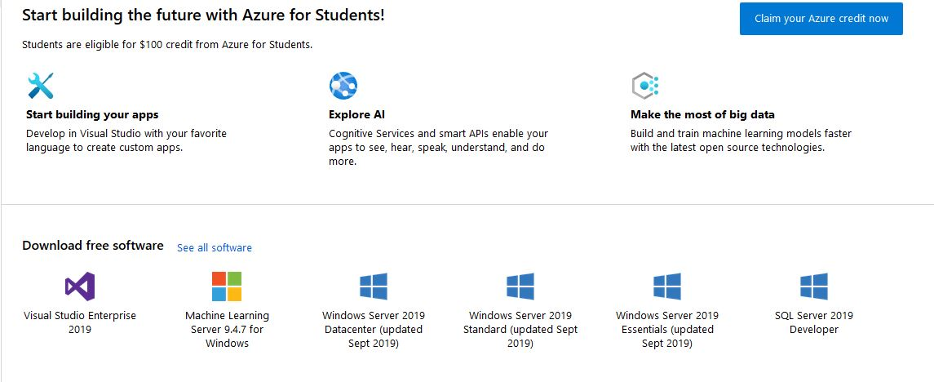
Software for class
Visual Studio
Download from Microsoft Azure site
https://azureforeducation.microsoft.com/devtools
Login using your Full Sail credentials

Slide 21
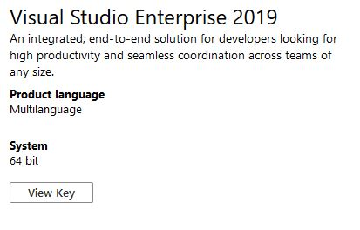

Software for class
Click on the Visual Studio Enterprise 2019 icon
Press the download button (should be bottom right of page)
Press the View Key button and RECORD/COPY the key

Slide 22
Software for class
Find the downloaded Visual Studio file on your computer
Run the downloaded Visual Studio application to complete the installation.
Select the packages/components you want to install. At a minimum install C# and C++. You can choose to install any other packages you’d like
This step can take a while (15+ minutes) depending on your internet connection speed and the components you select

Slide 23
Software for class
Discord
Download from the discord website
https://discordapp.com/
Create a discord account
If you already have an account, you do not need another
Join the FS GDBS & CSBS discord server
https://discord.gg/jhGnbFCpPS
Go to the student section and verify your account
If you run into problems, let me know ASAP – I’ll have to verify that you were added to the discord roster
Once your account is verified, join the PG1 discussion group
Type PG1 in the text box and press enter

Slide 24
Software for class
OBS Studio
OBS Studio is freeware, open source recording software
You can download OBS at
https://obsproject.com/download
Test and experiment with the software as soon as you install it
Many students have reported that they’ve run into a problem with OBS and have to change from the NVIDIA graphics card to the onboard graphics card on their laptops

Slide 25
Software for class
Internet
Google/Bing/Search engines can be useful for learning various approaches to an algorithm or how to implement a specific programming statement. Be forewarned, many of the online examples are intended for more experienced engineers and can be confusing. Do let the examples overwhelm you
Full Sail Online (FSO). You should already have a good bit of experience with FSO. Your assignments are listed and submitted on FSO. Additionally, there are two different class discussion boards available. The first is a general class interest board to share information. The second is exclusively for the Programmer’s Choice assignment
YouTube. You will upload your Programmer’s Choice video to YouTube (or a similar video sharing site). After the video is uploaded, you’ll have to post the video’s line to the discussion board on FSO (the link only, do not embed the video in FSO)

Slide 27
C# input & Output
Interacting with the USER

Slide 28
C# Input & Output
In PG1 all assignment are Console applications
C# provides a variety of Console class statements (methods) to allow input from the user and output to the user
The Console class is found in the System namespace (so you have to include: using System; at the beginning your file to access the class (or provide a completely resolved name)
In addition to input & output statements, there are several formatting statements available

Slide 29
C# Input & Output
Input & output can be thought of as a conversation between the program and the user
Purposes of I/O statemtents
Output statements can
Provide information to the user
Ask the user questions
Input statement allow the user to
Direct the program
Respond to questions

Slide 30
C# Input & Output
C# output statements
Console.Write(message)
Displays a message on the screen, the cursor remains at then end of the message (same line, adjacent to last character displayed)
message is a string (a collection of characters delineated by quotation marks)
E.g. “This is a string”
So it this ➔ “” (even though there aren’t any letters in the quotation marks)
This is not a string (no quotation marks)
‘This isn’t a string either’ (it would cause a compiler (syntax) error

Slide 31
C# Input & Output
C# output statements
Console.WriteLine(message)
Same as Console.Write except the cursor is moved down one line and to the left margin (like pressing the enter key in a document)
Console.WriteLine()
If no string is enclosed in the parentheses, will just move the cursor down one line and to the left margin (used for printing a blank line)

Slide 32
C# Input & Output
C# output statements
Escape characters
Special characters that allow strings to include ‘non-printable’ characters
A backslash character followed by another ‘non-printable’ character
For example, since strings begin and end with a quotation mark, the escape-quotation mark allows a quotation mark to be displayed

Slide 33
C# Input & Output
C# output statements
Escape characters
Common escape characters \” Prints a quotation mark \n Prints a new line (enter) character \t Prints a tab character (uses the value assigned as a system Tab) \’ Prints an apostrophe \b Prints a backspace character \\ Displays a backslash character \a Sounds the system alert tone

Slide 34
C# Input & Output
C# input statements
Console.ReadLine()
Reads (accepts) all keyboard input from the user until the ‘Enter’ key is pressed. When the user presses the ‘Enter’ key, all characters are returned as a C# string object.
Console.ReadKey()
Waits for the user to press any key before continuing
Will not directly return the key pressed (it is accessible, but requires more work to retrieve)
Commonly used to make content remain on the screen until the user is ready to move ahead
It’s a good practice to prompt the user to ‘Press any key to continue” if you use this technique

Slide 35
C# Input & Output
C# input statements
Console.Read()
Reads (accepts) all keyboard input from the user until the ‘Enter’ key is pressed. When the user presses the ‘Enter’ key, all characters are returned as a C# string object.
Console.Read reads characters from the console. It returns, each value entered as an integer until it reaches a zero value. The zero indicates the end of the input.
This should be used in a loop to ensure all characters in the buffer are processed

Slide 37
Create & submit assignments
‘How-to’ Guide

Slide 38
Create & Submit
Creating a C# project in PG1
Open Visual Studio
Select the Create a new project on the splash screen
Alternatively, if the program is already running, you can select ‘New project’ from the file menu
On the next screen, select
Console App (.NET Framework) – must be this exact project type
Press the next button

Slide 39
Create & Submit
Creating a C# project in PG1
The next screen displays several text fields
In the Project name, field enter a name for your project
In the Location field enter the folder where you will store you project
You press the ‘…’ button to browse your folder structure
Do not store your project on a Cloud drive (no OneDrive, SharePoint or Google Drive)
It’s a good idea to create a ‘working’ folder to store your projects and a ‘testing’ folder where you can move/copy projects for testing to prevent accidentally damaging a program
After entering name and location, press the enter key (or the ‘Create’ button)

Slide 40
Create & Submit
Creating a C# project in PG1
Enter (type) your program
Follow any instructions provided to create the intended program
Save/Debug/Test your program

Slide 41
Create & Submit
Submitting a C# project in PG1
When the program is completed (saved/tested/fully debugged)
Exit from Visual Studio (you cannot create a complete zip file while the program is still open in Visual Studio)
Go to your ‘working’ folder
There should be a folder stored there with the name of your project
Enter the project folder and verify it contains the solution file (.sln extension)
When you find the .sln file, move up one folder level
Zip the folder that contains the .sln file
Do not try to decide what to include, just zip the entire folder

Slide 42
Create & Submit
Submitting a C# project in PG1
Rename the zip folder so that it includes both your name and the name of the project
Do not rename any other files or folders
Copy the zip file to your ‘testing’ folder
Extract the project
Attempt to open the project (double click the .sln file)
Attempt to run the project
If there are any errors re-trace the process to locate the error(s)
Upload the zip folder on FSO
If you miss the due date, you can no longer ‘submit’ your assignment. Instead submit the late assignment on the same page, but submit it as ‘feedback’

Slide 44
Programmer’s choice
Passion Project

Slide 45
Programmer’s choice
You will be required to write an original program using any programming language you choose (with the caveat, it must be a language included in as part of your degree)
HTML and CSS are not acceptable. HTML is a markup language, not a programming language. CSS are style sheets used to format website appearance
If you choose a language that is not part of your degree, you must get permission before you begin working on the program
You will not submit the source code for the program, as such
The program can be as simple or as complex as you choose
The program does not have to complete, but the portion written must compile and run correctly (so some parts can be marked as ‘implement later’)

Slide 46
Programmer’s choice
You will be required to make a video of your programming running
The video must be at least 1 minute in length and should not exceed 2 minutes. The minimum time is non-negotiable (no credit for submission); however, a video that is a little long (< 2.5 minutes) is acceptable
Spend no more than 3-5 seconds showing your code. The video should highlight your program as it is running
Your video must include a ‘voice-over’ describing your program as it runs, specifically the portion being shown
Describe the purpose/intent of the program and what your are showing
Do not describe the process of writing the program (that goes on FSO)

Slide 47
Programmer’s choice
You must post your video to a video sharing website (i.e. YouTube)
A link to the video must be posted to the FSO Programmer’s Choice discussion page so your classmate can view and comment on your project
Do not embed the video on the FSO discussion page – just post a link
The post on FSO must include any ‘lessons learned’ while completing the assignment
Lessons learned should include any obstacles or opportunities encountered and how you handled them (overcame or implemented)
You must provide a meaningful critique to at least one other person’s video (can be positive or negative feedback, but must be polite and meaningful)
Response to feedback does NOT satisfy this requirement
Campus students – feedback to your partner/team does NOT satisfy this requirement

Slide 48
Programmer’s choice
Scoring rubric for Programmer’s Choice
10% Write program in appropriate language
15% Create a video of program running
Make sure you introduce yourself and your program
Video must show your program running (not your code in the IDE/Development engine)
Ensure the video quality is clear – if the fonts are too small in a Console application, increase the font so it appears clearly (‘in focus’). Make sure colors are clearly visible
10% Video is between 1 & 2 minutes in length
This is a ‘hard’ limit – no less than one minute, no longer than 2 minutes

Slide 49
Programmer’s choice
Scoring rubric for Programmer’s Choice
20% Video includes a voice-over describing the program
Must be audible (review your video prior to submission – check the audio levels)
15% Post video to video sharing site
The video must be assessable to anyone who has the link (it cannot be private or require a log in on the site)
15% A written description of any ‘lessons learned’ posted to FSO
This should include the reason you choose this specific program to submit
Include any obstacles or opportunities encountered and how you handled/plan to handle them
15% Meaningful feedback to at least one classmate about their submission

